Slide 1
Jenson J
Project Title: Enterprise financial payments and Document Management System

Slide 2
Problem statement
Managing company financial transactions is often inefficient and insecure when handled by everyone or using scattered tools, which can lead to errors, data loss, and lack of security. There is often no centralized system to store transaction details along with supporting documents like invoices or receipts. This makes tracking payments, due dates, and transaction history difficult. Therefore, there is a need for a secure and efficient digital system to manage and organize financial transactions effectively.

Slide 3

Proposed solution
To address these challenges, a web-based Financial Transaction Management System is developed to provide a secure and centralized platform for managing company transactions.
The system allows authorized finance managers to add, update, delete, and track financial transactions efficiently and allows users to only view the completed transactions of the Enterprise.
It also enables uploading and downloading supporting documents such as invoices and receipts.
The application ensures data security through JWT-based authentication and encrypted password storage.

Slide 4
objectives
To develop a centralized finance management system that allows only the finance manager to manage all transaction operations securely using authenticated credentials.
To use a role-based access to limit other users of the Enterprise to only view the completed transactions of the Enterprise.
To implement a secure authentication mechanism using JWT and store authentication tokens in HTTP-only cookies to prevent unauthorized access.
To design an analytics dashboard that provides insights and monitoring of financial transaction data.
To develop a transaction management module that allows viewing complete transaction history and performing CRUD (Create, Read, Update, Delete) operations.
To develop a pending payments module that displays all pending and overdue transactions for better payment tracking.
To implement an alerts system that notifies transactions that are approaching their due date within one month.
To ensure secure credential management by allowing password updates and storing passwords securely using BCrypt encryption.

Slide 5
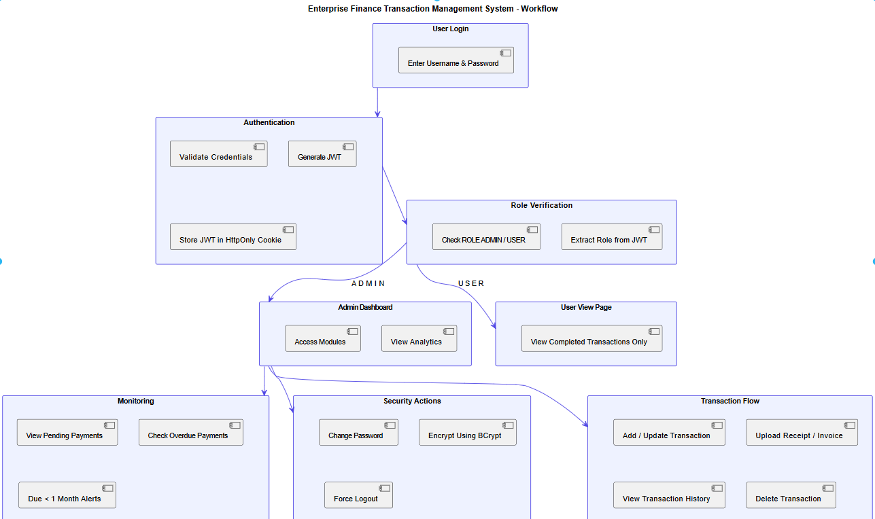
Workflow

Slide 6

Thank you

